Slide 1
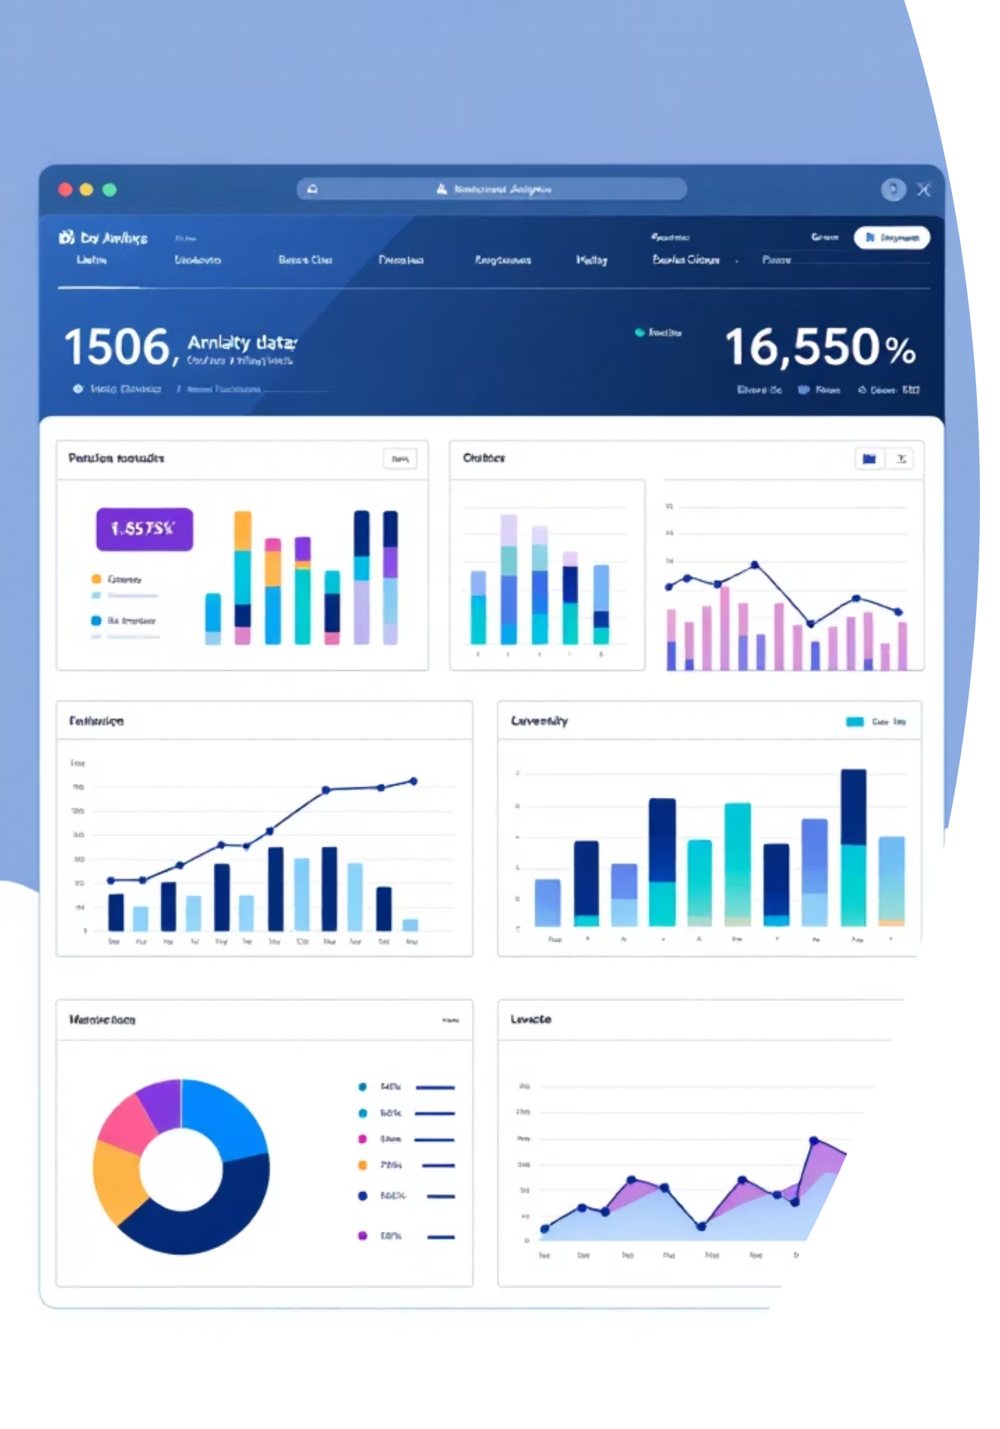
Customer Shopping Behavior Analysis
Uncovering insights from 3,900 purchases to guide strategic business decisions through data-driven analysis of spending patterns, customer segments, and product preferences.

Slide 2


DATASET OVERVIEW
Understanding Our Data Foundation
3.9k
18
50
Total Purchases
Data Columns
Locations
Comprehensive transaction records analyzed
Rich feature set covering demographics and behavior
Geographic diversity across customer base
Our dataset captures customer demographics including age, gender, and location, alongside detailed purchase information such as item category, purchase amount, season, size, and color. Shopping behavior metrics include discount usage, promo codes, previous purchases, review ratings, and shipping preferences.

Slide 3
DATA PREPARATION
Python-Powered Data Cleaning
01
02
Data Loading & Exploration
Missing Data Handling
Imported dataset using pandas and performed initial structure analysis with df.info() and summary statistics
Imputed 37 missing Review Rating values using median rating by product category
03
04
Feature Engineering
Database Integration
Created age_group bins and purchase_frequency_days columns for enhanced analysis
Connected to PostgreSQL and loaded cleaned data for SQL-based business analysis

Slide 4
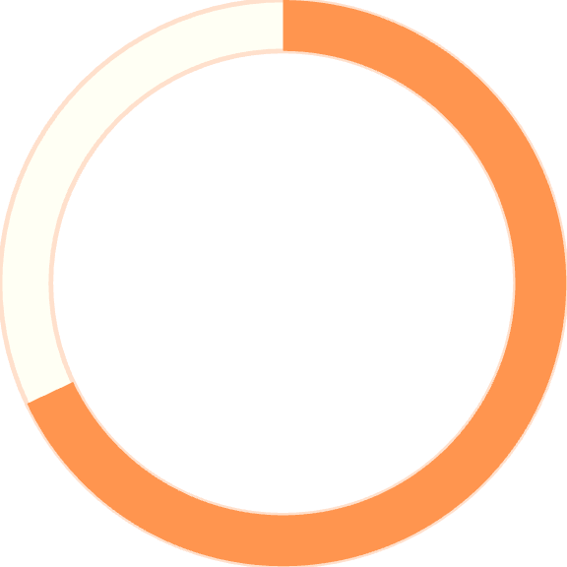
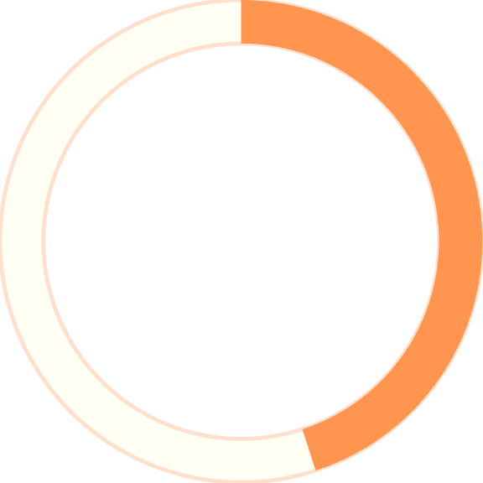
Key Statistical Insights
Purchase Patterns
Average purchase amount: $59.76 with a standard deviation of $23.69, ranging from $20 to $100. Customer ages span 18-70 years with a median of 44 years.
68%
Average review rating: 3.75 out of 5.0, indicating generally positive customer satisfaction across all product categories.
Male Customers
Dominant customer segment
45%
Clothing Category
Largest product category

Slide 5
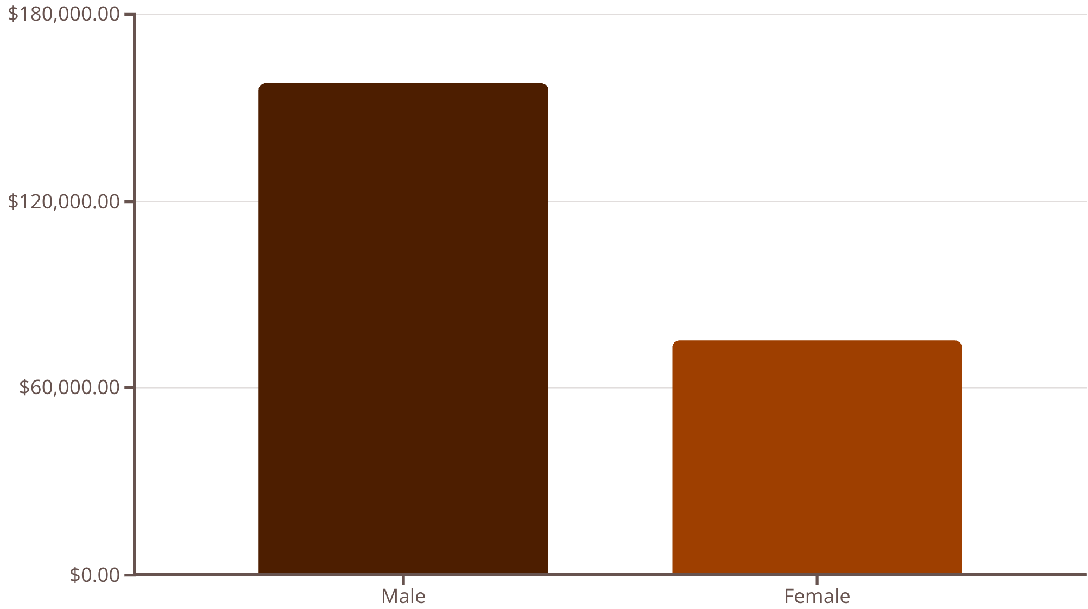
SQL ANALYSIS
Revenue Analysis by Gender
Male Customers Drive Revenue
Male customers generate $157,890 in total revenue, more than double the $75,191 from female customers. This 68% male customer base represents a significant revenue concentration.
This insight suggests opportunities for targeted marketing campaigns and product development focused on male preferences while exploring growth potential in the female segment.

Slide 6

Top-Rated Products & Shipping Insights
Highest-Rated Products
Shipping Type Comparison
77%
Express shipping customers spend an average of $60.48 compared to $58.46 for standard shipping users—a modest $2.02 difference.
Gloves
This suggests express shipping appeals to slightly higher-spending customers, presenting an opportunity to promote premium shipping options to increase average order value.
3.86 average rating
77%
Sandals
3.84 average rating
76%
Boots
3.82 average rating

Slide 7
Subscription Status Analysis
27%
Subscription Opportunity
Subscribers average $59.49 per purchase while non-subscribers spend $59.87—nearly identical spending patterns. However, non-subscribers generate $170,436 in total revenue versus $62,645 from subscribers.
Subscribers
1,053 customers
The minimal spending difference but massive revenue gap highlights a significant opportunity: converting more customers to subscription status could stabilize revenue streams without requiring increased per-transaction spending.
73%
Non-Subscribers
2,847 customers

Slide 8



CUSTOMER SEGMENTS
Customer Loyalty Segmentation
Loyal Customers
Returning Customers
New Customers
3,116 customers (80%) with multiple repeat purchases form our core base
701 customers (18%) showing promising engagement and growth potential
83 customers (2%) representing fresh acquisition opportunities
Among repeat buyers with 5+ purchases, 958 are subscribers while 2,518 are not—indicating that frequent purchasers don't necessarily convert to subscriptions, presenting a clear retention opportunity.

Slide 9
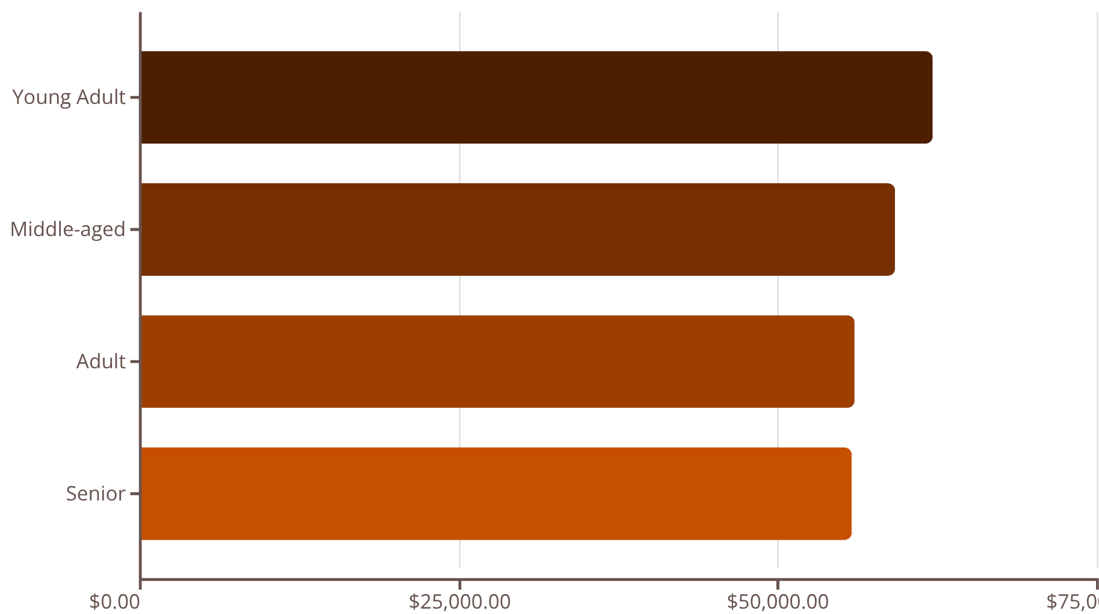
Revenue Distribution by Age Group
Balanced Age Demographics
Revenue distribution across age groups is remarkably balanced, with Young Adults leading at $62,143 and Seniors contributing $55,763.
This even distribution suggests our product mix appeals across generations, but also indicates untapped potential for age-specific marketing campaigns and product positioning strategies.

Slide 10
STRATEGIC RECOMMENDATIONS
Data-Driven Action Plan
Boost Subscriptions
Loyalty Programs
Optimize Discounts
Promote exclusive benefits to convert the 73% non-subscriber base, especially targeting the 2,518 repeat buyers without subscriptions
Reward the 701 returning customers to accelerate their journey into the loyal segment of 3,116 customers
Review discount strategy for products like Hats (50% discount rate) and Sneakers (49.66%) to balance sales growth with margin protection
Product Positioning
Targeted Marketing
Highlight top-rated items (Gloves, Sandals, Boots) and best-sellers (Blouse, Jewelry) in marketing campaigns
Focus campaigns on Young Adults ($62K revenue) and express-shipping users ($60.48 average spend) for maximum ROI

